Slide 1

Category Code: C5
Problem Statement Title: AI-Powered Investment & Trading Assistant
Team Name: T-bits
Institute Name: Vivekanand Education Society’s Institute of Technology

Slide 2

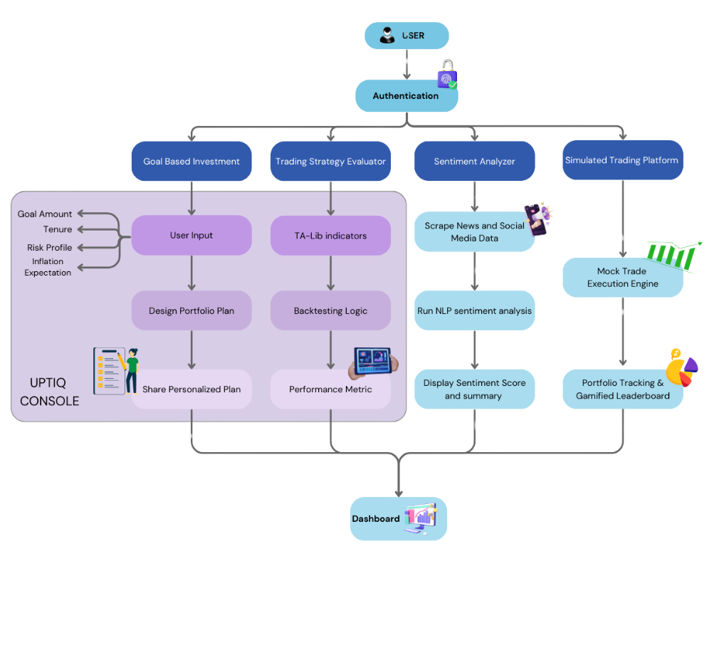
Idea / Approach details (& implemented features)
Problem Statement
Retail investors lack personalized guidance and real-time insights.
Evaluating strategies and analyzing sentiment requires expertise, leading to poor decisions.
Solution
AI-powered assistant integrates goal-based planning, strategy evaluation, sentiment analysis, and simulated trading.
Uses UPTIQ Console to automate financial decisions and provide personalized recommendations.

Slide 3
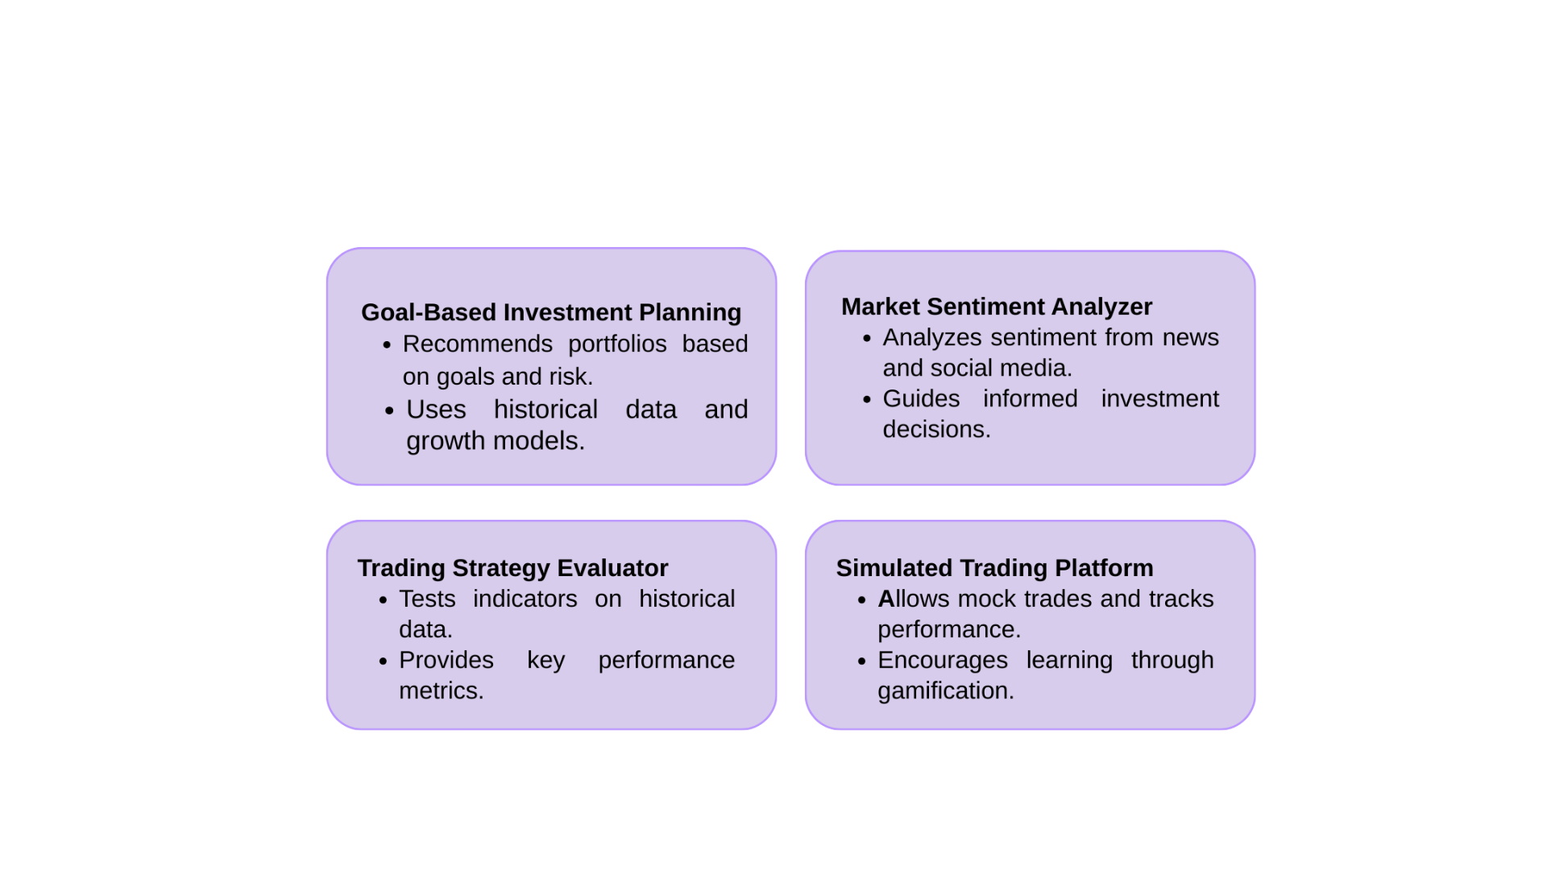
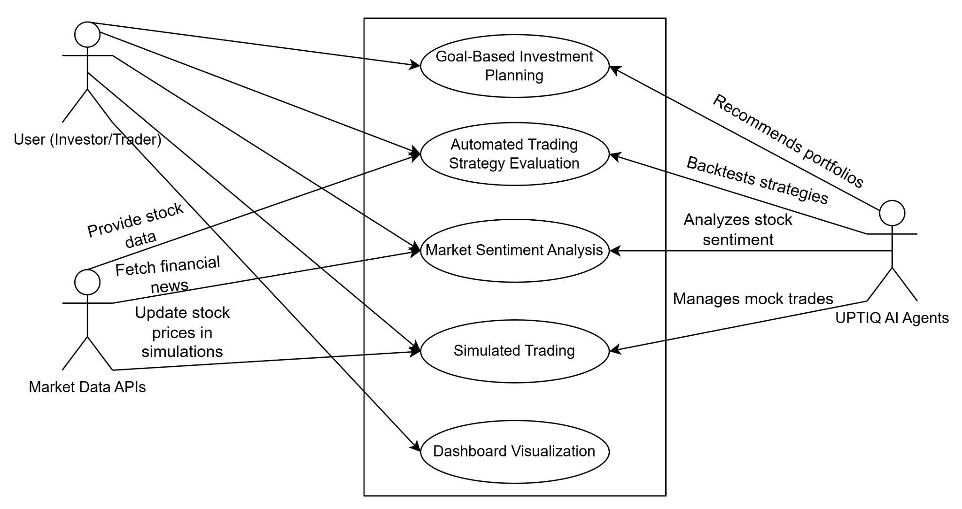
Innovation (Showstopper)/ Use Case Diagram

Slide 4
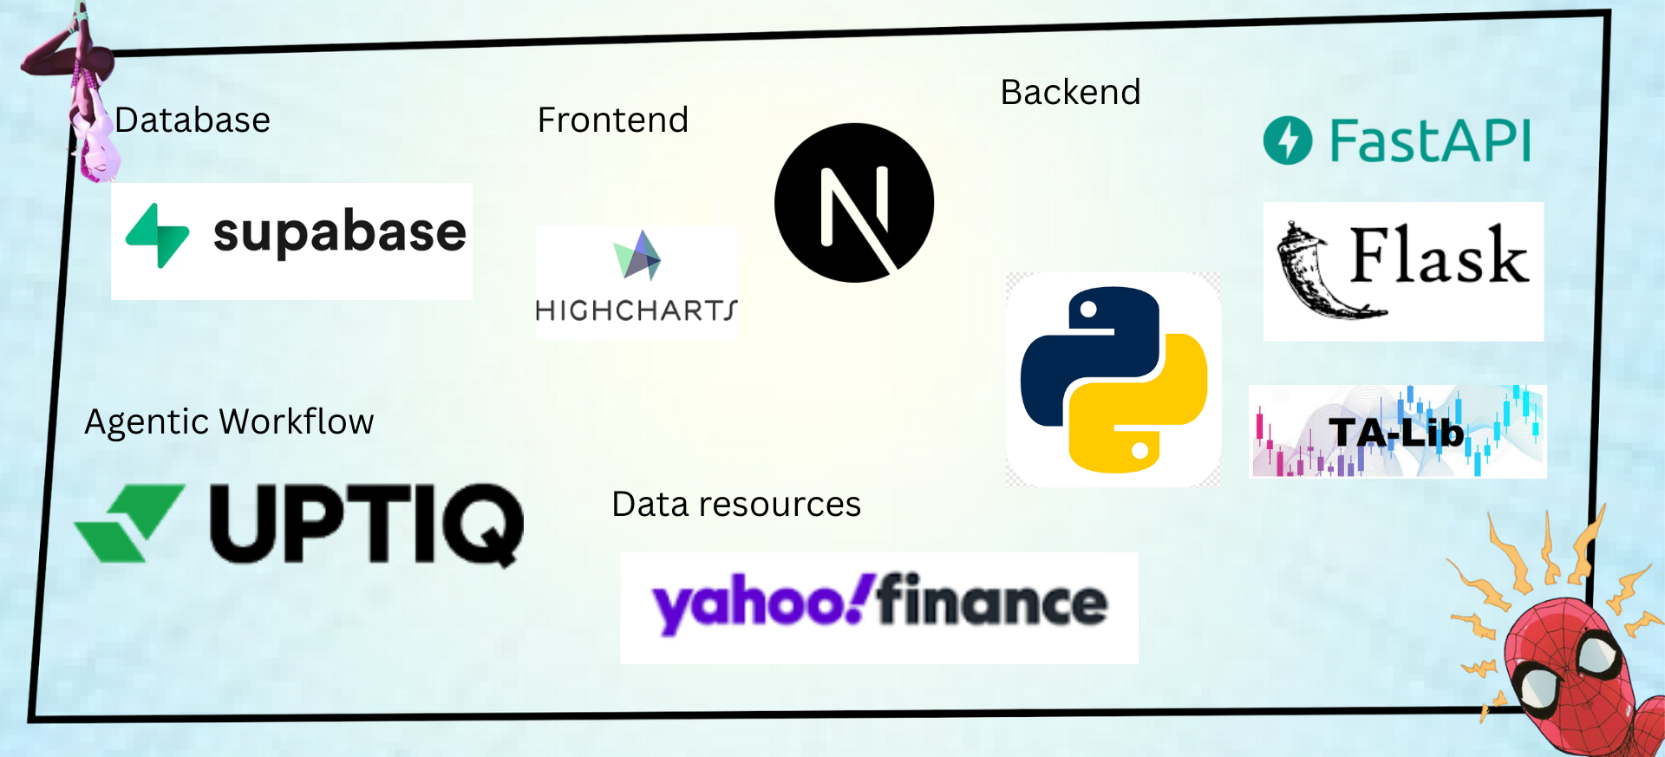
Tech Stack

Slide 5
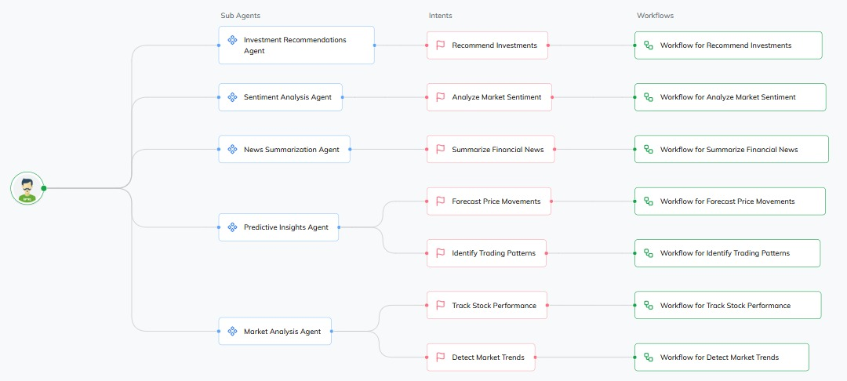
In case of Uptiq category - Your Uptiq Agent (explain in detail)
The current implementation focuses on the Investment Recommendations Agent, which uses the Recommend Investments intent and its associated workflow to provide personalized investment suggestions based on user inputs. While this is the only sub-agent fully built out so far, the overall architecture is designed to support additional capabilities through other sub-agents like Sentiment Analysis, News Summarization, Predictive Insights, and Market Analysis. These sub-agents are structured to handle intents such as analyzing market sentiment, summarizing financial news, forecasting price movements, and tracking stock performance, each linked to its own workflow for future development.
AI Agent Overview

Slide 6
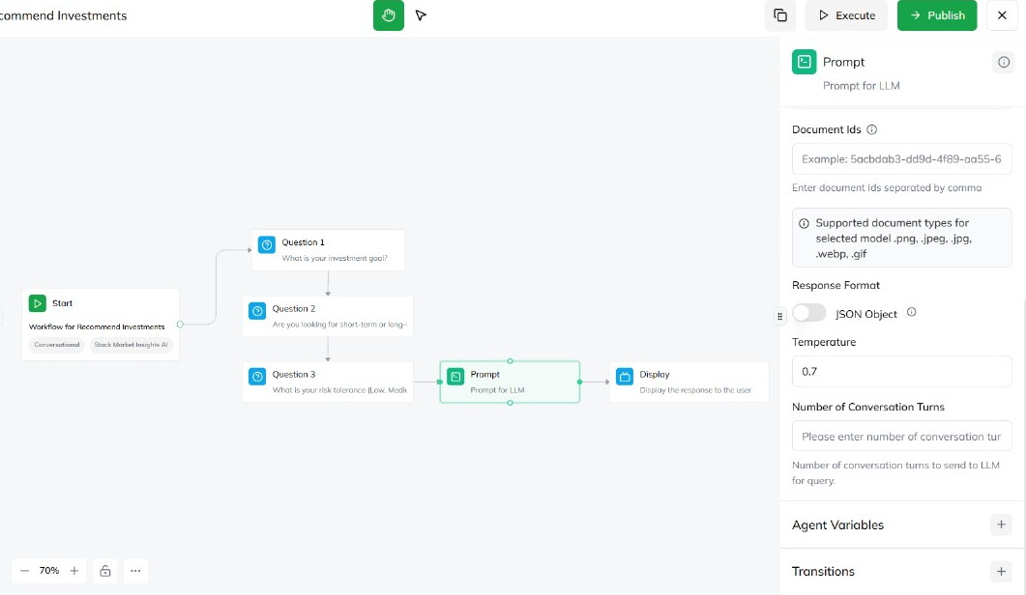
In case of Uptiq category - Your Uptiq Agent (explain in detail)
The intent of the Recommend Investments workflow is to suggest suitable investment options based on the user's financial preferences. The workflow begins with three key Question nodes that collect the user's investment goal, time horizon, and risk tolerance. These inputs are stored in variables (investment_goal, investment_horizon, risk_tolerance). A Prompt node is then used to send these inputs to an LLM (e.g., GPT-4), configured with a system prompt instructing it to recommend three ideal investment options. The AI-generated recommendations are finally shown to the user using a Display node.
Goal Based Agent - Workflow

Slide 7
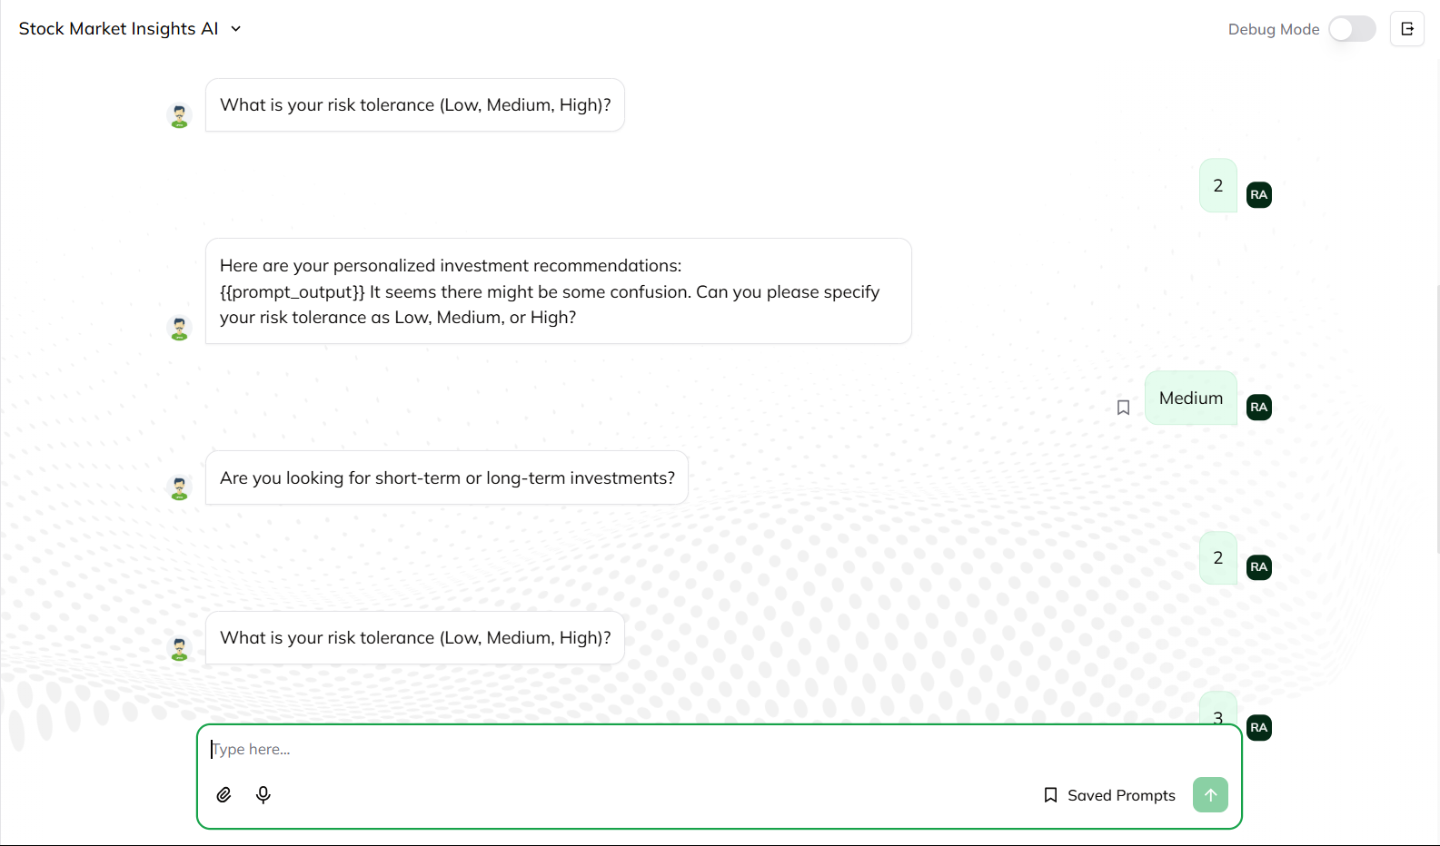
In case of Uptiq category - Your Uptiq Agent (explain in detail)
This interface demonstrates a conversational flow where investment-related questions are asked interactively to ensure a user-friendly experience. By collecting inputs like risk tolerance and investment horizon in a natural dialogue format, the system makes the process intuitive and engaging for users.
Goal based investment plan

Slide 8
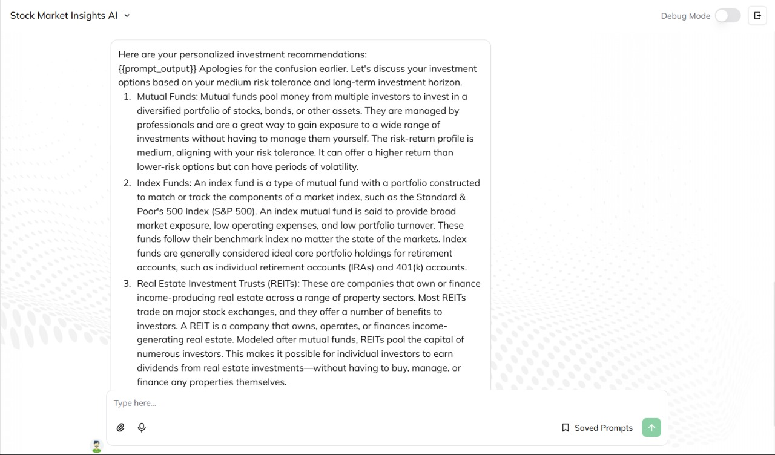
In case of Uptiq category - Your Uptiq Agent (explain in detail)
This screen shows the AI generating a detailed, personalized response with investment recommendations based on the user’s medium risk tolerance and long-term goals. The output is structured clearly, making it easy for the user to understand and evaluate suitable investment options in a conversational, informative format.
Recommendations by Agent

Slide 9
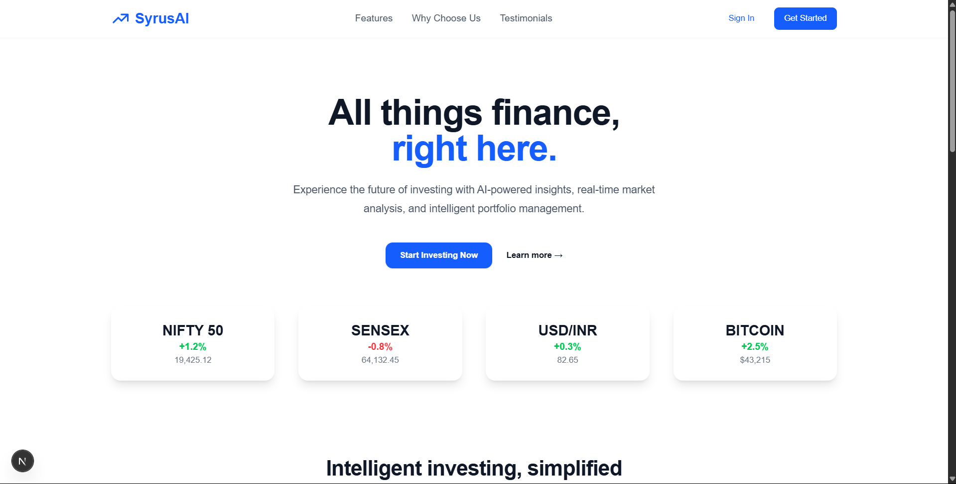
Implementation/Prototype/Use Case Diagram (screenshots)
Landing Page - an overview of features and signUp/login option

Slide 10
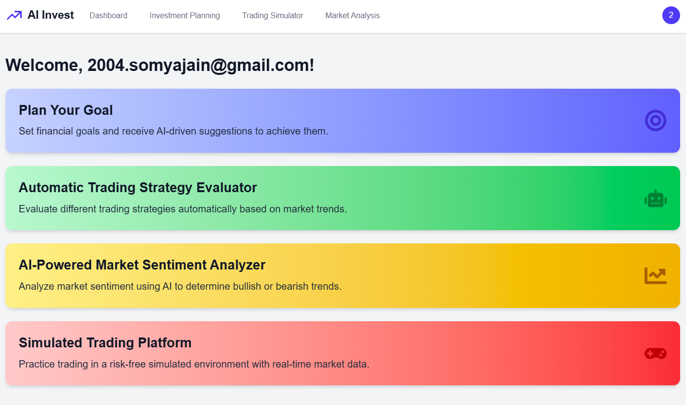
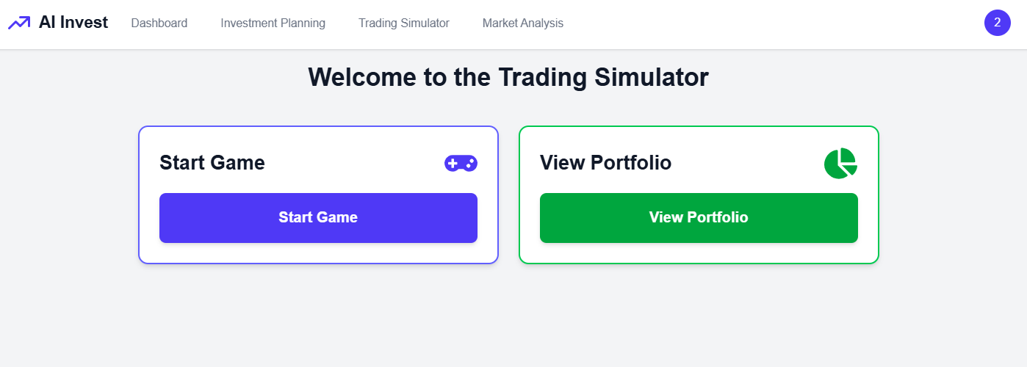
Outputs (Frontend)
Trading Simulator - A game based environment where user can use game money(points) to buy/sell game stocks.
User Dashboard

Slide 11
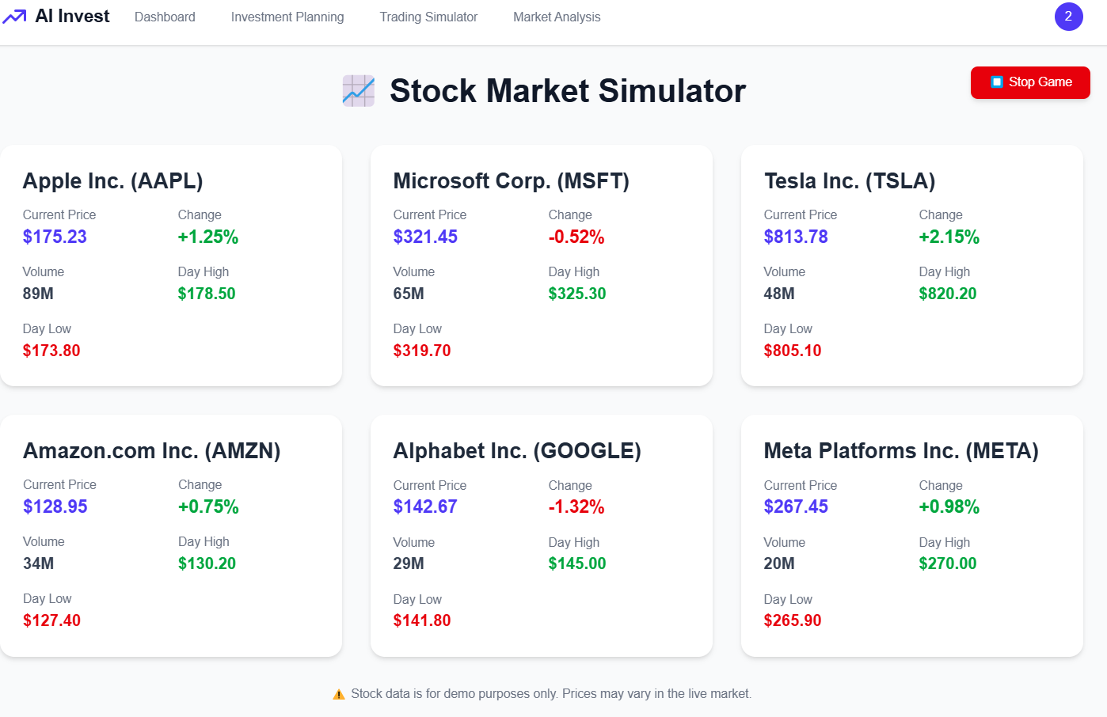
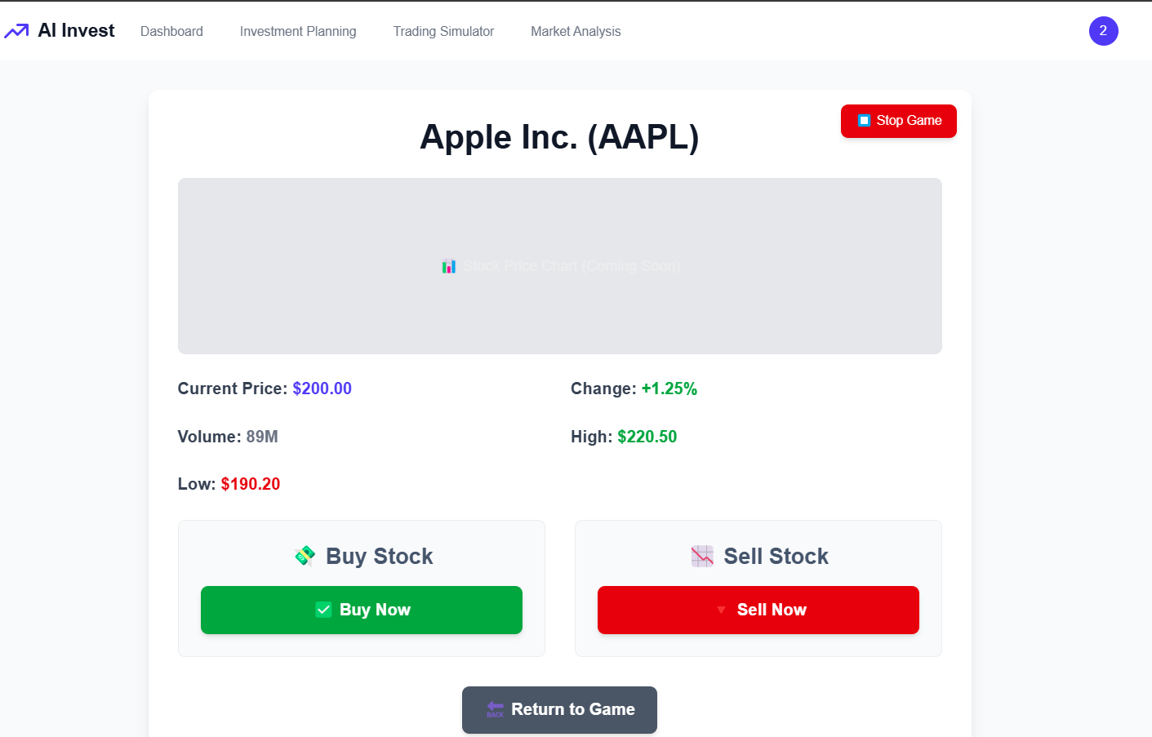
Outputs (Frontend)
Game stocks list
Buy/sell the game stock

Slide 12
Future Objectives
Improve AI Accuracy – Integrate deep learning to detect patterns, e.g., Tesla stock surging after earnings reports, for better predictions.
Multi-Asset Support – Expand analysis to crypto (Bitcoin trends), ETFs (S&P 500), and commodities (Gold price shifts) for diversified insights.
Real-Time Risk Alerts – AI detects sudden Nvidia stock drops (e.g., 5% in pre-market) and alerts users instantly.
Personalized Strategies – AI adapts; e.g., if a user prefers low-risk dividend stocks, it suggests Coca-Cola over Tesla.

